Slide 1
Foundations of Data Science & Analytics DSCI 633, Fall 2021
Lecture 17
(material sources cited in last slide)
Nidhi Rastogi
Assistant Professor, GCCIS, RIT
October 21, 2021

Slide 2
Course Information
GitHub link - https://github.com/aiforsec/RIT-DSCI-633-FDS
Assignment 6 assigned. Due at 11:59 pm on 10/26. No extensions. Project starts 10/28.
Reach out to TA/ Instructor during office hours, via Slack, or email for any questions, suggestions, concerns, or general chat about data science.

Slide 3
Semi-Supervised Learning (SSL)

Slide 4
Learning Problems
Supervised learning:
Given a sample consisting of object-label pairs find the predictive relationship between objects and labels.
Un-supervised learning:
Given a sample consisting of only objects, look for interesting structures in the data, and group similar objects.
What is Semi-supervised learning?
Supervised learning + Additional unlabeled data
Unsupervised learning + Additional labeled data

Slide 5
Motivation
Classification tasks in Machine Learning
the more the data available to train algorithms, the better
In supervised learning,
data labeled with respect to target class
What are some of the issues in this approach?
when building large, labeled data sets for classification

Slide 6
ISSUES
Labeling data can be time-consuming.
1,000,000 dog to be fed to a classification algorithm
Goal: Predicting “Boston Terrier”
What would be the first task to prepare this large dataset for a supervised classification task?
-> a human to look at each image, determine if Boston Terrier is present.
Labeling data can be expensive.
painstakingly scour 1,000,000 dog pictures -> $$$$

Slide 7
Motivation
With Limited time and money to label some of a large data se
Can we Leave the rest unlabeled?
Can this unlabeled data somehow be used in a classification algorithm?

Slide 8
Semi-Supervised Learning (SSL)
Train a classifier on small amount of labeled data
Use classifier to make predictions on the unlabeled data
Predictions likely better than random guessing
unlabeled data predictions adopted as ‘pseudo-labels’ in subsequent iterations
this specific technique is called self-training.

Slide 9
SSL Use case
Data with 100 observations
30 are labeled (Supervised), rest are unlabeled (Unsupervised)
What type of problem is this?
It is a classification problem
Performance achieved by training on 30 observations lesser compared to training on 100 observations

Slide 10
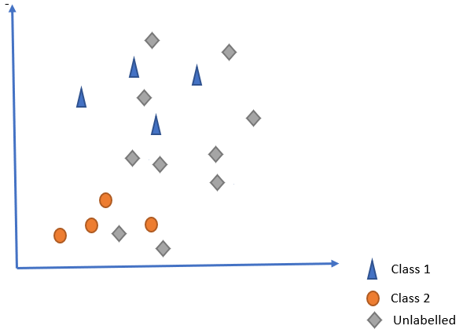
Semi-Supervised Learning (SSL)
Essentially a binary classification problem
Labeled classes
blue triangle
orange circles
Unlabeled class
greyed diamonds

Slide 11
Semi-Supervised Learning (SSL)
What should be our strategy of training our classifier?

Slide 12
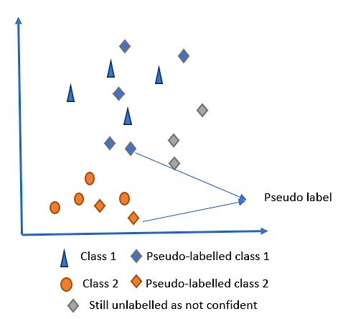
Semi-Supervised Learning (SSL)
Build a classifier on the labeled data
2. Use this to predict the unlabeled data. Check confidence level.
3: Add observations to training data with moderate confidence. (pseudo-label)
4. Augment training dataset

Slide 13
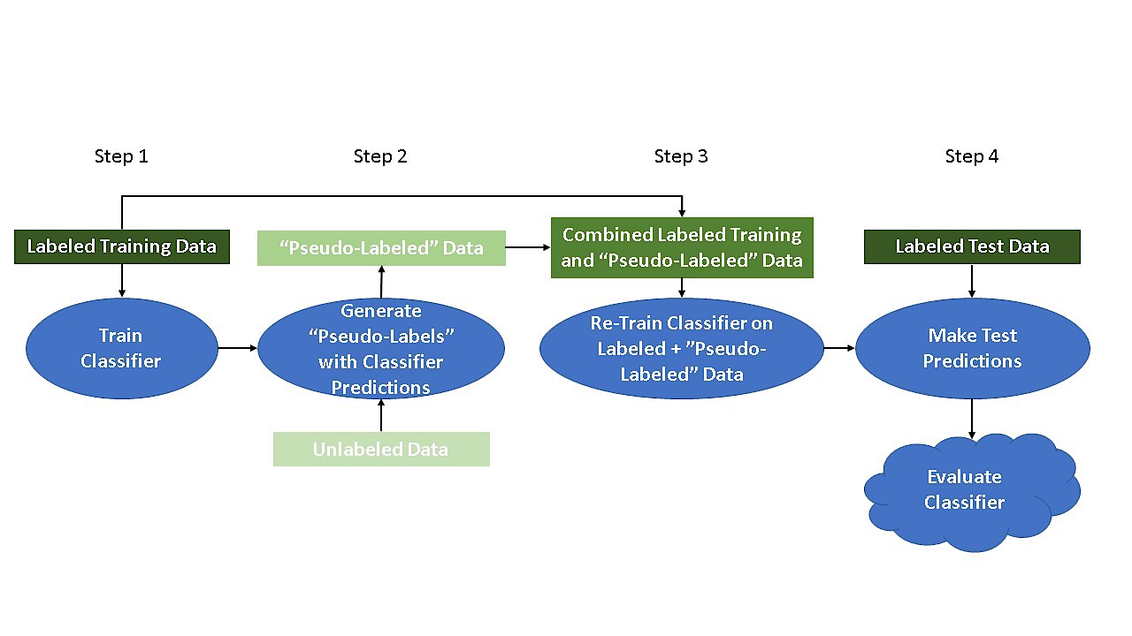
A bit more formally…

Slide 14
Step 1
Split labeled data - test/train

Slide 15
Step 2
Use trained classifier to predict class labels for unlabeled data
Ones with highest probability of being correct adopted as ‘pseudo-labels’.

Slide 16
Step 3
Concatenate ‘pseudo-labeled’ data with labeled training data.
Re-train classifier on combined pseudo+training data

Slide 17
Step 4
Use trained classifier to predict class labels for the labeled test data instances
Evaluate classifier performance

Slide 18
Steps 1 through 4 can be repeated until no more predicted class labels from Step 2 meet a specific probability threshold, or until no more unlabeled data remains.

Slide 19
Example – Photo tagging @scale
How would this work using semi-supervised learning?
Think: Semi-supervised is a combination of supervised and unsupervised.

Slide 20
Example – Photo tagging @scale
Photo-hosting services like Google Photos, Facebook photo tag recommender
Once photos uploaded, it automatically recognizes same person A in photos 1, 5, and 11. B shows up in photos 2, 5, and 7
Unsupervised part
System needs you to tell it who these people are
Just one label per person, and it is able to name everyone in every photo
→ Supervised part

Slide 21
Two Algorithmic Approaches
Classifier based methods:
Start from initial classifier(s), and iteratively enhance it (them)
Data based methods:
Discover an inherent geometry in the data, and exploit it in finding a good classifier.

Slide 22
Algorithmic Approaches
Self-Training
Co-Training
Gaussian Mixture Model (GMM)
Other: Graph-based methods, Semi-Supervised SVM

Slide 23
Algorithmic Approaches
Self-Training (example of photos)
Co-Training
Gaussian Mixture Model (GMM)
Other: Graph-based methods, Semi-Supervised SVM

Slide 24
Self-Training
Previous Algorithm was self-training
How is confidence/ weights assigned to pseudo labels?
Concrete example – 1NN

Slide 25
Self-Training

Slide 26
Self-Training with 1NN: Well separated case

Slide 27
Self-Training with 1NN: Outlier Case

Slide 28
Self-Training : Advantages
The simplest semi-supervised learning method.
A wrapper method, i.e., the technique can be applied to any existing learning algorithms.
Often used in real tasks like natural language processing.

Slide 29
Self-Training : Disadvantages
Early mistakes could reinforce themselves.
Heuristic solutions, e.g. “un-label” an instance if its confidence falls below a threshold.
Cannot say too much in terms of convergence, but …
There are special cases when self-training is equivalent to the Expectation-Maximization (EM) algorithm.

Slide 30
Algorithmic Approaches
Self-Training (example of photos)
Co-Training
Gaussian Mixture Model (GMM)
Other: Graph-based methods, Semi-Supervised SVM

Slide 31
Co-Training (Intuition)
Leveraging Multiple Views: classifying collection of university webpages into 2 categories: Student, Faculty.
Webpage can be classified by: • text on the webpage (e.g., words such as “professor”) • the words in all the hyperlinks that point to that webpage
View 1 “professor” “grant” “graduated”
View 2 my advisor my Ph.D. advisor my mentor
Notes:
Suppose we are classifying a collection of university webpages into two categories: Student vs Faculty.

Slide 32
Leveraging Multiple views
In named entity classification, we classify a named entity (i.e., a proper name such as “Washington State” or Mr. Washington”) by a class label (e.g., Person or Location).
Each instance is represented by two views:
the set of words that make up the named entity itself
the words in the context of the named entity

Slide 33
Co-Training
But there are so many ways to express a Person or Location?
So how do we learn with no labeled data?

Slide 34
Co-Training
Inst 1: “headquartered in” seems to indicate y=Location.
Inst 3: “Kazakhstan” must be a Location since it appears with the context “headquartered in”
Inst 4: “flew to” must be about Location because it is in the context of “Kazakhstan
“Location”
Even though we have never seen the word “China”!

Slide 35
Co-Training
Inst 2: “Mr.” seems to indicate y=Person.
Inst 5: “partner at” must be about a Person because it appears in context of “Mr”
“Person”
Even though we have never seen the words “Robert Jordan”!

Slide 36
Co-Training
Appropriate in settings where features redundant
Train two classifiers on disjoint features
make 2 two classifiers take turns teaching each other
Co-training is different from self-training in that we use two classifiers in turn, operating on different views of the instances.
Notes:
Appropriate in settings where the features are redundant
The idea is to train two classifiers on the disjoint features, and make the two classifiers take turns teaching each other
Co-training is different from self-training in that we use two classifiers in turn, operating on different views of the instances.

Slide 37
Co-Training Algorithm
Train two classifiers: f⁽¹⁾ from (X_{l}⁽¹⁾, Y_{l}), f⁽²⁾ from (X_{l}⁽²⁾, Y_{l})
Classify X_{u} with a classifier f⁽¹⁾ and f⁽²⁾ separately.
3. Add f⁽¹⁾’s k-most-confident (x, f⁽¹⁾(x)) to f⁽²⁾’s labeled data
4. Add f⁽²⁾’s k-most-confident (x, f⁽²⁾(x)) to f⁽¹⁾’s labeled data
5. Repeat

Slide 38
Co-Training - pseudocode

Slide 39
Co-Training: pros/cons
Pros:
wrapper method: it does not matter what algorithms are used for the two classifiers f(1) and f(2)
requires that classifiers can assign a confidence score to their prediction, which is used to select which unlabeled instances to turn into additional training data for the other view.
less sensitive to mistakes than self-training
Cons:
feature split may not exist
classifier that use both feature sets may have better performance

Slide 40
Co-Training - Assumptions
existence of two views x = [x⁽¹⁾, x⁽²⁾]
assumption #1: each view alone is sufficient to make good classifications, given enough labeled data.
assumption #2: the two views are conditionally independent given the class label
knowing one view doesn’t affect what we will observe for the other view
e.g., context “headquartered in” does not favor any particular location.

Slide 41
Co-Training - Uses
Many real-world problems of this type
Semantic lexicon generation
Web page classification
Word sense disambiguation
Speech recognition
Visual classification of cars

Slide 42
Algorithmic Approaches
Self-Training
Co-Training
Gaussian Mixture Model (GMM)
Other: Graph-based methods, Semi-Supervised SVM

Slide 43
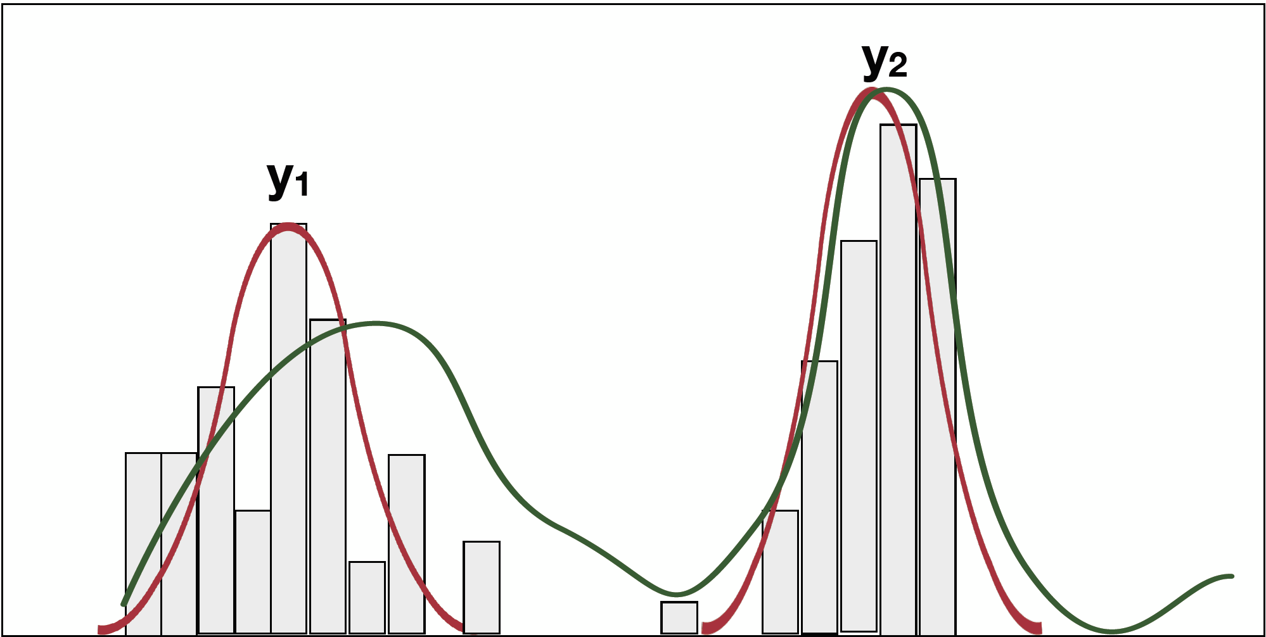
Modeling Data using Distributions
In mixture models, we assume that we have a set of hidden mixture components {1,…,K} which generated the data.

Slide 44
Generative story of GMM
Idea: Fit data with a combination of Gaussian distributions
Specifically, we assume that the data that we observed has been generated by repeating the following two steps:
pick a mixture component
y ∼ p(y) = Multinomial(π)
2. generated x based on the selected mixture component:
x ∼ p(x| y = k) = 𝒩(x; μ_{k}, σ_{k})
to give the joint distribution:
p(x, y) = p(y) p(x| y)
mixing proportions: a vector of
probabilities that sum to 1

Slide 45
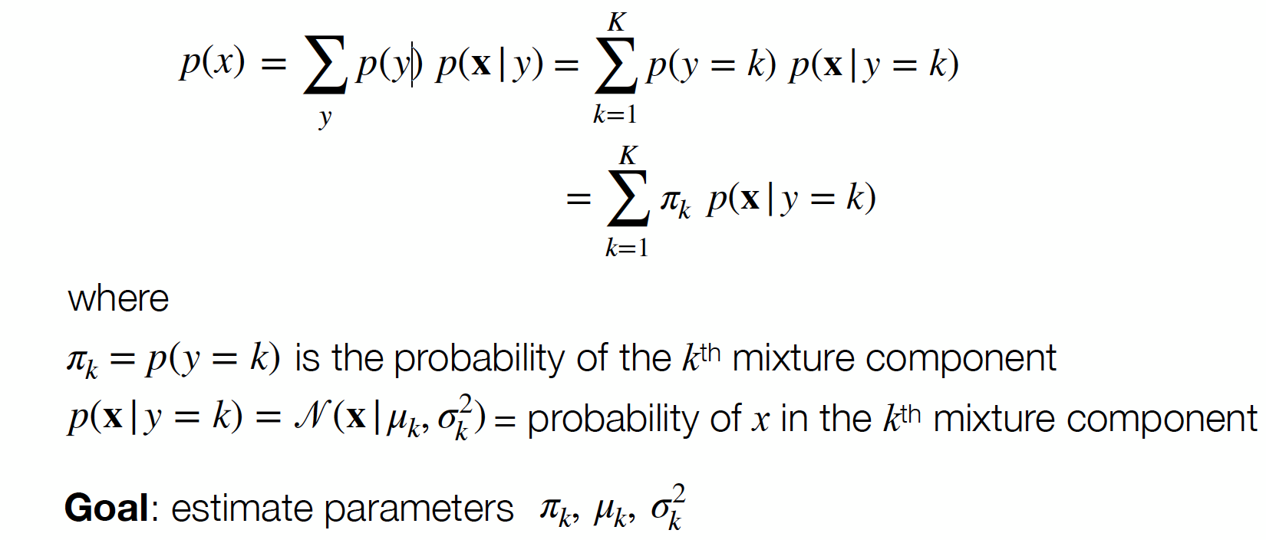
GMM
We can compute the probability density function p(x) over by summing out y:

Slide 46
GMM
Why do we care to learn these parameters
Think of each mixture component as a class.
The unlabeled data tells us how instances from all classes, mixed together, are distributed.
If we know how the instances from each class are distributed, then we can decompose the mixture into individual classes.

Slide 47
GMM: Supervised/Semi-Supervised
Given labeled data, assume each class has a Gaussian distribution …

Slide 48
GMM: Supervised/Semi-Supervised
Given labeled data, assume each class has a Gaussian distribution
The most likely model and its decision boundary …

Slide 49
GMM: Supervised/Semi-Supervised
Given labeled data, assume each class has a Gaussian distribution
The most likely model and its decision boundary …
Add unlabeled data..

Slide 50
GMM: Supervised/Semi-Supervised
Given labeled data, assume each class has a Gaussian distribution
The most likely model and its decision boundary …
Add unlabeled data..
With unlabeled data, the most likely model and decision boundary changed.

Slide 51
GMM: Supervised/Semi-Supervised
Decision boundaries are different because they maximize different quantities.

Slide 52
GMM: Finding the Parameters
If we have labeled data, then it’s just a matter of finding the maximum likelihood estimate of the parameters.
With unlabeled data, we are left with marginal probability in the data likelihood. i.e., the probability of generating x from any of the classes (because we do not know which class the instances belong to).
Using EM

Slide 53
Expectation Maximization (EM)
Start with some initial parameter setting.
Repeat (as long as desired):
Expectation (E) step: Complete the data by assigning “values” to the missing items.
Maximization (M) step: Compute the maximum likelihood parameter setting based on the completed data.

Slide 54
A Simple Algorithm: K-means clustering
Objective: Cluster n instances into K distinct classes.
Preliminaries:
Step 1: Pick the desired number of clusters, K.
Step 2: Assume a parametric distribution for each class (e.g. Normal).
Step 3: Randomly estimate the parameters of the K distributions.
Iterate, until convergence:
Step 4: Assign instances to the most likely classes based on the current parametric distributions. <Expectation Step>
Step 5: Estimate the parametric distribution of each class based on the latest assignment. <Maximization step>

Slide 55
Assumptions of GMM
The assumption is that data comes from the mixture, where the number of components, prior p(y) and conditional probability p(x|y) are all correct.

Slide 56
Alternative: Cluster then label
Instead of running EM with the probabilistic generative model using the labeled data:
Run the clustering algorithm assuming all data is unlabeled.
Train a supervised learner using the labeled instances that fall into each cluster.
Use the predictor to label unlabeled instances in that cluster.

Slide 57
Cluster then label
Pros:
Another simple wrapper method
Do not have to assume a probabilistic mixture model.
Con:
Can be difficult to analyze; labels within a cluster may disagree.

Slide 58
Pop-Quiz

Slide 59
Attributions
Some of these slides are based on material towardsdatascience.com
Coding exercise is from Kaggle.com (it’s best place to practice!)

